Slide 1
An introduction to SVG
D3 training – 2

Slide 2

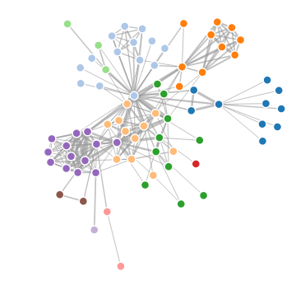
Examples of SVG

Slide 3
Why SVG?
SVG is very good for things like animation and interaction (which is generally a good thing for visualization).
SVG works with primitive shapes like rectangles, lines and circles (also good for visualization).
SVG is an open, non-proprietary format and is widely supported.

Slide 4
And now the good news.
SVG is very similar to HTML.
<svg width=100 height=100>
<rect x=10 y=10 width=50 height=50 style="fill:black;"></rect>
</svg>
It's also all about adding elements to containers.
And, there are much fewer elements than HTML!

Slide 5
How much is there to know?
Like with HTML, you really don't need to be an expert of SVG to make things with d3.
Although honestly – you will need to be familiar with more than 2 elements to get started.

Slide 6
SVG elements
<svg>
This is the top-level container. It is very much like <body> in HTML, in that that everything else is added to it.

Slide 7
SVG elements
<g>
The g element is the other container element. (much like <div> in HTML).
The big difference is that everything is that all other graphical elements must be added to either <svg> or <g> elements. Much fewer elements can act as containers in SVG.

Slide 8
Primitive shapes
<rect>, <circle>, <line>
These elements make rectangles, circles and simple, straight lines.
They are really used a lot in d3: to draw bar charts, scatterplots, the ticks in the axes…
There are also elements for ellipses and polygons, which will be less useful to us (but they are there).

Slide 9
Path
<path>
This one element is the most useful of the language. It can do any form of open or closed shape – straight lines, curves, anything really.
With d3 we use it a lot, especially to create line charts, area charts.

Slide 10
Text
<text>
SVG does text, too.
In d3, this is useful for labels or legends.

Slide 11
Attributes and style?
SVG elements have attributes and style, too, just like HTML.
In fact, attributes are more used in SVG than in HTML, because they control the position and the size of the elements.

